Slide 1

SRM INSTITUTE OF SCIENCE AND TECHNOLOGY
DATA STRUCTURES AND ALGORITHMS (18CSC162J)
UNIT IV

Slide 2
SRM INSTITUTE OF SCIENCE AND TECHNOLOGY
TOPICS TO BE COVERED
COMPLETE BINARY TREE AND ITS HEIGHT
BINARY SEARCH TREE
INSERTION
DELETION AND
SEARCHING

Slide 3
SRM INSTITUTE OF SCIENCE AND TECHNOLOGY
INTRODUCTION TO BINARY TREE
WHAT IS BINARY TREE?
COMPLETE BINARY TREE AND ITS HEIGHT

Slide 4
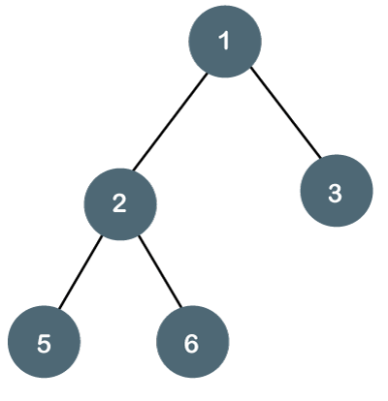
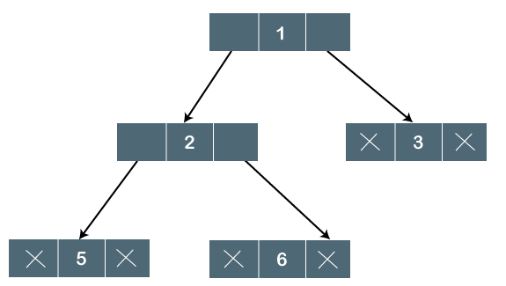
SRM INSTITUTE OF SCIENCE AND TECHNOLOGY
WHAT IS BINARY TREE?
A BINARY TREE IS A TYPE OF TREE DATA STRUCTURE IN WHICH EACH NODE CAN HAVE AT MOST TWO CHILD NODES, KNOWN AS THE LEFT CHILD AND THE RIGHT CHILD.

Slide 5

SRM INSTITUTE OF SCIENCE AND TECHNOLOGY
TYPES OF BINARY TREE
FULL BINARY TREE
COMPLETE BINARY TREE
FULL BINARY TREE
THE TREE CAN ONLY BE CONSIDERED AS THE FULL BINARY TREE IF EACH NODE MUST CONTAIN EITHER 0 OR 2 CHILDREN

Slide 6
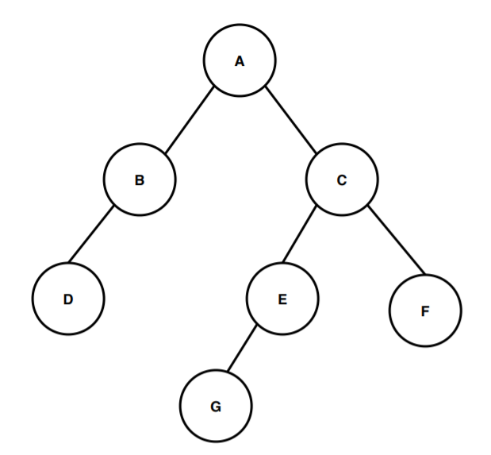
BINARY TREE
THE HEIGHT OF A NODE IN A BINARY TREE IS THE LARGEST NUMBER OF EDGES IN A PATH FROM A LEAF NODE TO A TARGET NODE
THE DEPTH OF A NODE IN A BINARY TREE IS THE TOTAL NUMBER OF EDGES FROM THE ROOT NODE TO THE TARGET NODE.
Example

Slide 7
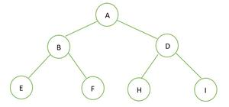
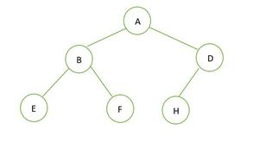
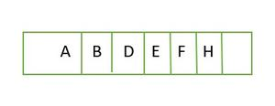

PERFECT BINARY TREE VS COMPLETE BINARY TREE:
A BINARY TREE OF HEIGHT ‘H’ HAVING THE MAXIMUM NUMBER OF NODES IS A PERFECT BINARY TREE. FOR A GIVEN HEIGHT H, THE MAXIMUM NUMBER OF NODES IS 2^{H+1}-1.
A COMPLETE BINARY TREE OF HEIGHT H IS A PERFECT BINARY TREE UP TO HEIGHT H-1, AND IN THE LAST LEVEL ELEMENT ARE STORED IN LEFT TO RIGHT ORDER.
EXAMPLE 1: EXAMPLE 2:
TREE IS N= 2^{H+1}-1 = 2²⁺¹-1 = 2³-1 = 7. 2^{H+1} – 1 = 2²⁺¹ – 1 = 2³ – 1 = 7.
COMPLETE BINARY TREE

Slide 8
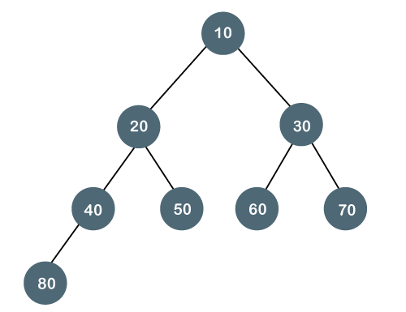
SRM INSTITUTE OF SCIENCE AND TECHNOLOGY
COMPLETE BINARY TREE
THE COMPLETE BINARY TREE IS A TREE IN WHICH ALL THE NODES ARE COMPLETELY FILLED EXCEPT THE LAST LEVEL. IN THE LAST LEVEL, ALL THE NODES MUST BE AS LEFT AS POSSIBLE. IN A COMPLETE BINARY TREE, THE NODES SHOULD BE ADDED FROM THE LEFT.

Slide 9
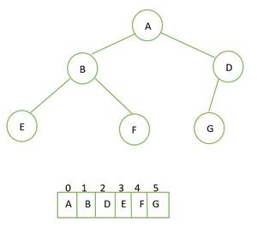
COMPLETE BINARY TREE
SRM INSTITUTE OF SCIENCE AND TECHNOLOGY
CREATION OF COMPLETE BINARY TREE
ALGORITHM
STEP 1: INITIALIZE THE ROOT WITH A NEW NODE WHEN THE TREE IS EMPTY.
STEP 2: IF THE TREE IS NOT EMPTY THEN GET THE FRONT ELEMENT
IF THE FRONT ELEMENT DOES NOT HAVE A LEFT CHILD THEN SET THE LEFT CHILD TO A NEW NODE
IF THE RIGHT CHILD IS NOT PRESENT SET THE RIGHT CHILD AS A NEW NODE
STEP 3: IF THE NODE HAS BOTH THE CHILDREN THEN POP IT FROM THE QUEUE.
STEP 4: ENQUEUE THE NEW DATA.

Slide 10
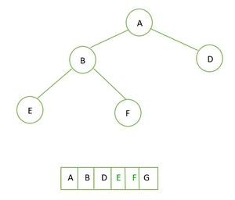


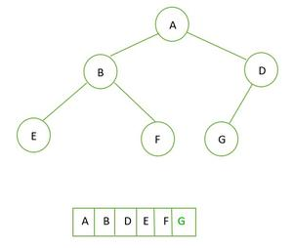
COMPLETE BINARY TREE
SRM INSTITUTE OF SCIENCE AND TECHNOLOGY
ILLUSTRATION
STEP 1 STEP 2 STEP 3
STEP 4

Slide 11
COMPLETE BINARY TREE
PROPERTIES OF COMPLETE BINARY TREE
A COMPLETE BINARY TREE IS SAID TO BE A PROPER BINARY TREE WHERE ALL LEAVES HAVE THE SAME DEPTH.
IN A COMPLETE BINARY TREE NUMBER OF NODES AT DEPTH D IS 2^{D}.
IN A COMPLETE BINARY TREE WITH N NODES HEIGHT OF THE TREE IS LOG(N+1).
ALL THE LEVELS EXCEPT THE LAST LEVEL ARE COMPLETELY FULL

Slide 12
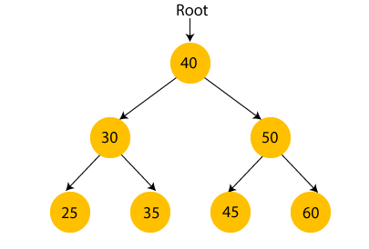
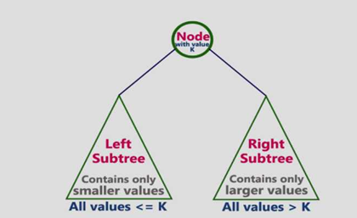
BINARY SEARCH TREE (BST)
SRM INSTITUTE OF SCIENCE AND TECHNOLOGY
A BINARY SEARCH TREE FOLLOWS SOME ORDER TO ARRANGE THE ELEMENTS. IN A BINARY SEARCH TREE, THE VALUE OF LEFT NODE MUST BE SMALLER THAN THE PARENT NODE, AND THE VALUE OF RIGHT NODE MUST BE GREATER THAN THE PARENT NODE.
OPERATIONS: INSERT, SEARCH, DELETE

Slide 13

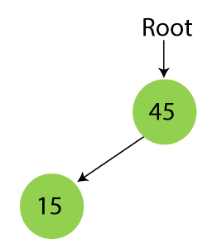
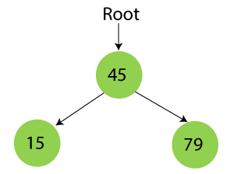
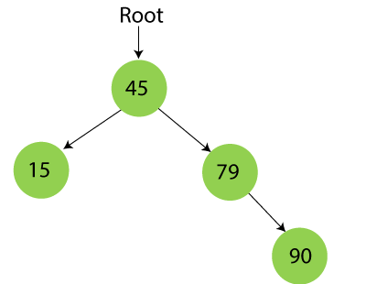
EXAMPLE OF CREATING A BINARY SEARCH TREE
SRM INSTITUTE OF SCIENCE AND TECHNOLOGY
SUPPOSE THE DATA ELEMENTS ARE - 45, 15, 79, 90, 10, 55, 12, 20, 50
STEP 1 - INSERT 45 STEP 2 - INSERT 15 STEP 3 - INSERT 79 STEP 4 - INSERT 90

Slide 14
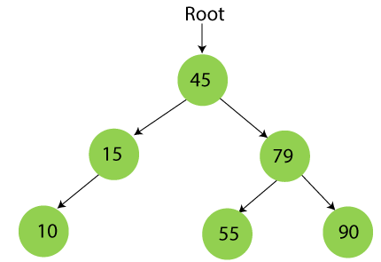
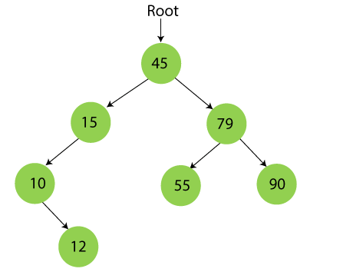
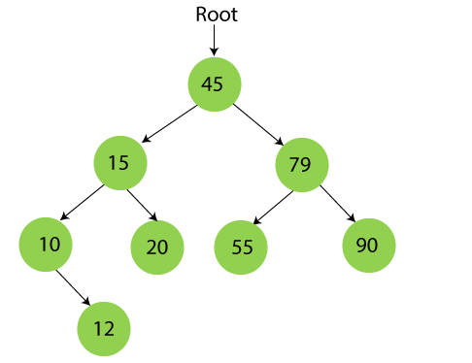
EXAMPLE OF CREATING A BINARY SEARCH TREE
SRM INSTITUTE OF SCIENCE AND TECHNOLOGY
STEP 6 - INSERT 55 STEP 7 - INSERT 12 STEP 8 - INSERT 20

Slide 15
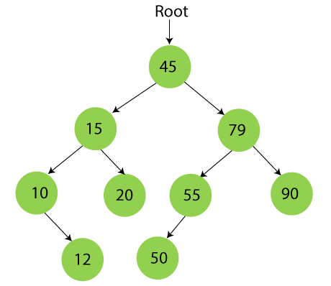
EXAMPLE OF CREATING A BINARY SEARCH TREE
SRM INSTITUTE OF SCIENCE AND TECHNOLOGY
STEP 9 - INSERT 50

Slide 16
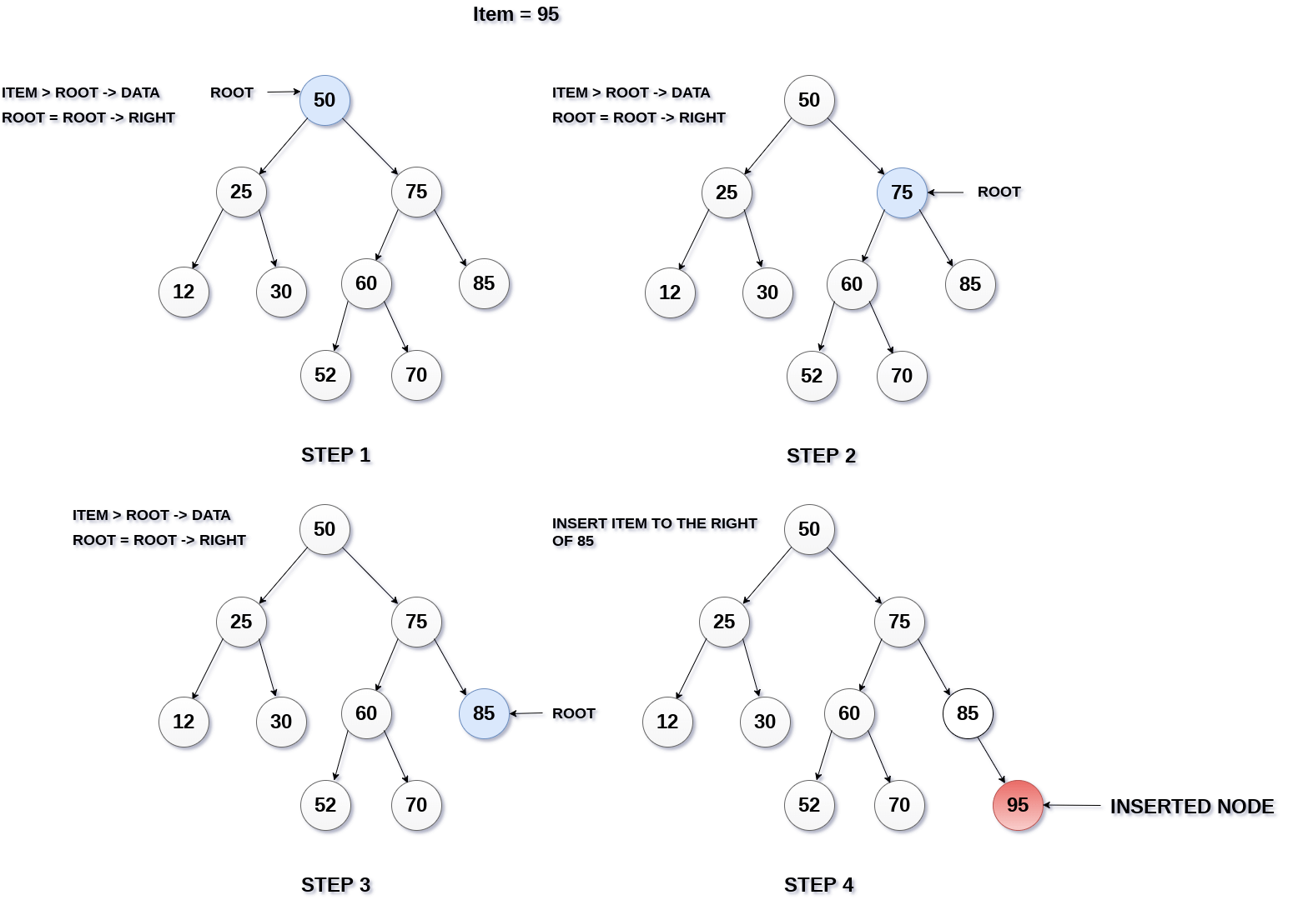
INSERTION OF A NEW NODE IN TO A BINARY SEARCH TREE
SRM INSTITUTE OF SCIENCE AND TECHNOLOGY
Insert (TREE, ITEM) Step 1: IF TREE = NULL Allocate memory for TREE SET TREE -> DATA = ITEM SET TREE -> LEFT = TREE -> RIGHT = NULL ELSE IF ITEM < TREE -> DATA Insert(TREE -> LEFT, ITEM) ELSE Insert(TREE -> RIGHT, ITEM) [END OF IF] [END OF IF] Step 2: END

Slide 17
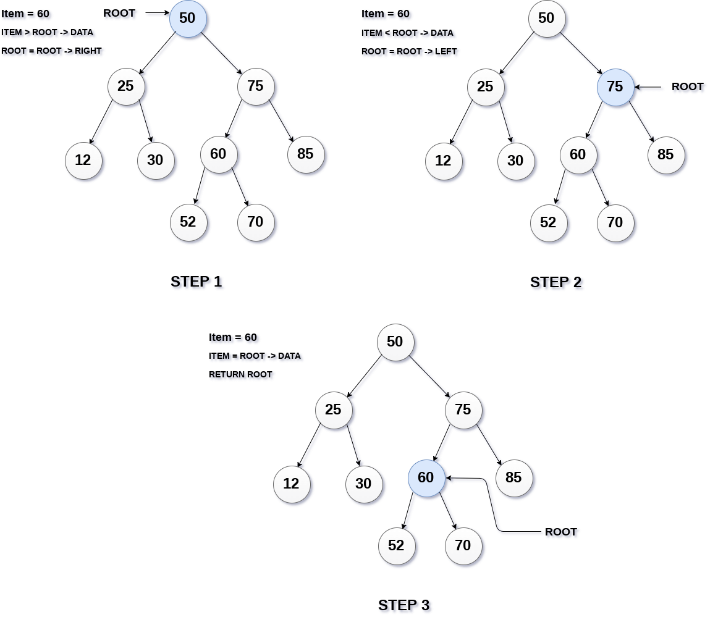
SEARCHING OF NODE IN BINARY TREE
SRM INSTITUTE OF SCIENCE AND TECHNOLOGY
Search (ROOT, ITEM) Step 1: IF ROOT -> DATA = ITEM OR ROOT = NULL Return ROOT ELSE IF ROOT < ROOT -> DATA Return search(ROOT -> LEFT, ITEM) ELSE Return search(ROOT -> RIGHT,ITEM) [END OF IF] [END OF IF] Step 2: END

Slide 18
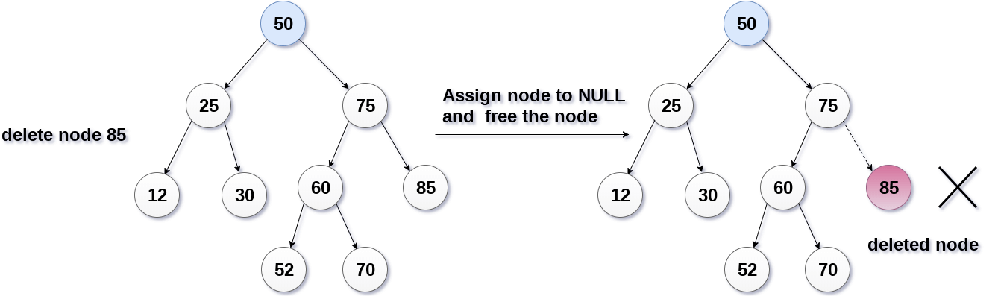
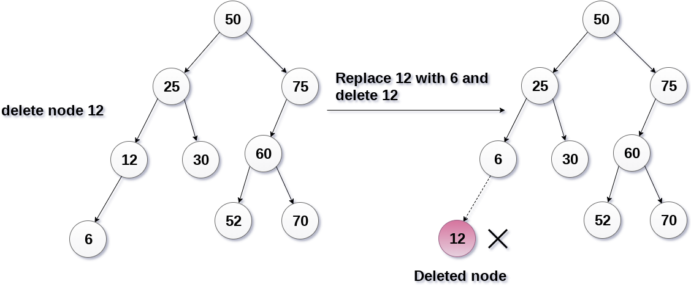
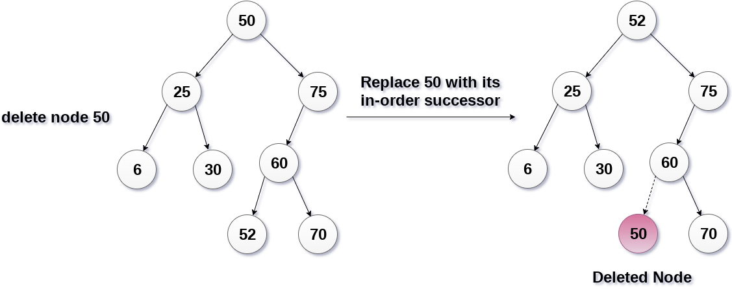
DELETION OF A NEW NODE IN A BINARY TREE
SRM INSTITUTE OF SCIENCE AND TECHNOLOGY
The node to be deleted is a leaf node The node to be deleted has only one child The node to be deleted has two children
Delete (TREE, ITEM) Step 1: IF TREE = NULL Write "item not found in the tree" ELSE IF ITEM < TREE -> DATA Delete(TREE->LEFT, ITEM) ELSE IF ITEM > TREE -> DATA Delete(TREE -> RIGHT, ITEM) ELSE IF TREE -> LEFT AND TREE -> RIGHT SET TEMP = findLargestNode(TREE -> LEFT) SET TREE -> DATA = TEMP -> DATA Delete(TREE -> LEFT, TEMP -> DATA) ELSE SET TEMP = TREE IF TREE -> LEFT = NULL AND TREE -> RIGHT = NULL SET TREE = NULL ELSE IF TREE -> LEFT != NULL SET TREE = TREE -> LEFT ELSE SET TREE = TREE -> RIGHT [END OF IF] FREE TEMP [END OF IF] Step 2: END

